Slide 1
A Study Of The Book Of Revelation
January 31, 2021

Slide 2

Revelation 12:13
Revelation 12
“And when the dragon saw that he was cast down to the earth, he persecuted the woman that brought forth the man (child).”

Slide 3
The Woman Persecuted
Revelation 12
Satan knows he must fight on earth.
This antagonism originated with Satan’s hatred for Christ!
He turns his attention to the children of his conqueror!
Primary application to Revelation is the Roman persecution, the beast’s great persecution of the church.
Yet, to this day Satan persecutes God’s children by encouraging them to abandon their faith!

Slide 4
Revelation 12:14
Revelation 12
“And there were given to the woman the two wings of the great eagle, that she might fly into the wilderness unto her place, where she is nourished for a time, and times, and half a time, from the face of the serpent.”
Revelation 11:3; 12:6, 14; 13:5; cf. Daniel 7:25

Slide 5
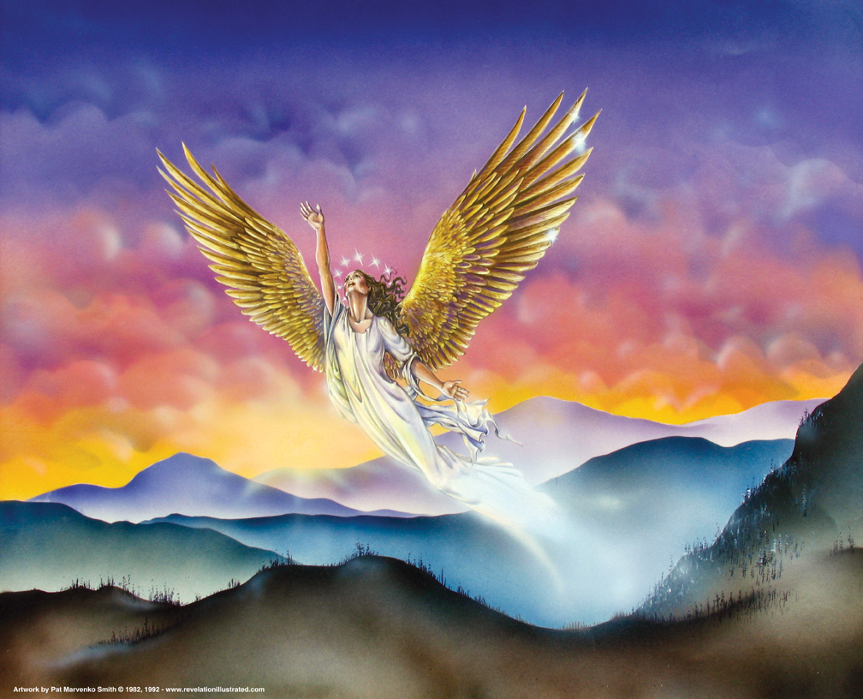
Revelation 12

Slide 6
Flight of the Woman
Revelation 12
Where she is nourished for a time, and times, and half a time, from the face of the serpent. Three and a half years is equivalent to 1,260 days (verse 6) and forty-two months occurring elsewhere in the book.
The two witnesses shall prophesy 1,260 days (11:3).
The holy city shall be trodden under foot forty-two months (11:2; 13:5).
The woman is nourished for a time, times, and half a time (12:6, 14).
The fourth kingdom would war against the saints for a “time, times, and the dividing of time” (Daniel 7:25). The fulfillment of Daniel’s prophecy is revealed to John. The recipients are under severe persecution from the Roman Empire.
The promise being assured throughout Revelation is that God will nourish His people through the time of testing.

Slide 7
Flight of the Woman
Revelation 12
God told the people of Israel that He carried them on eagles’ wings. (Exodus 19:4)
He delivered them by His power. (Deuteronomy 32:11; Psalm 36:7; Isaiah 40:31)
He gives “similar refuge” to the church.
“The woman flew into the wilderness to her place.” God’s people flee; under intense hardship and persecution.
There, she will be nourished.

Slide 8
Flight of the Woman
Revelation 12
The woman now represents those who stand for and with God. (Spiritual Israel)
She will be protected by God.
She will be able to resist evil and the devil’s scheme. (James 4:7-8; 1 Peter 5:8-9)
She may suffer physical persecution, but will ultimately be victorious. (Romans 8:35-39)

Slide 9
Revelation 12:15
Revelation 12
“And the serpent cast out of his mouth after the woman water as a river, that he might cause her to be carried away by the stream.”

Slide 10
Revelation 12:16
Revelation 12
“And the earth helped the woman, and the earth opened her mouth and swallowed up the river which the dragon cast out of his mouth.”

Slide 11
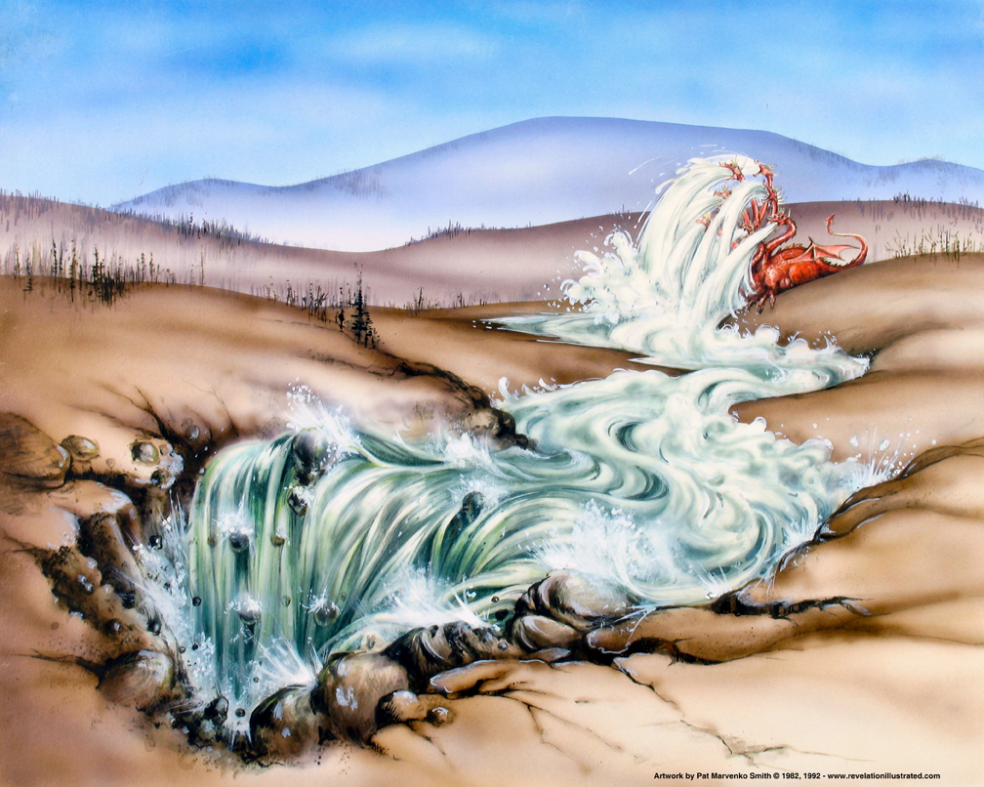
Revelation 12

Slide 12
The Dragon’s Attempt
Revelation 12
Though Satan ejected from his mouth a stream of water, as a flood to destroy her, the earth swallowed up the current and rescued the woman!
At one time, God used water to destroy evil. (1 Peter 3:20-21)
In the Old Testament, a flood signified tribulation from ungodly men who were overwhelming God’s people (Isaiah 8:5-8; Psalms 18:4).
God is able to dry up rivers so that He might protect His faithful (Isaiah 42:15; 43:2; Psalm 144:7).
The flood sent forth by the serpent points to his effort to drown the church in a torrent of Roman persecution. Satan’s “flood” is the use of ungodly men and methods. (Psalm 124:4, 58; 57:19-20; Ephesians 4:14)

Slide 13
Attempt Thwarted by God
Revelation 12
God caused the earth to help the woman.
The world absorbs/drinks up the flood sent by Satan. Mankind falls for and follows after Satan’s lies.
The earth came to the woman’s rescue by distracting Rome’s attention – political uprisings, local wars, and other conflicts.
Divine providence protected and sustained the woman and her offspring!

Slide 14
Revelation 12:17
Revelation 12
“And the dragon waxed wroth with the woman, and went away to make war with the rest of her seed, that keep the commandments of God, and hold the testimony of Jesus”

Slide 15
Rest of Her “Offspring”
Revelation 12
Revelation 12:17 – “the remnant of her seed,” KJV
Following the persecution depicted in Revelation, the woman now represents the faithful children of God in the church.
Satan will attack her children because God loves them.
He attacks them one by one, but to no avail.
God’s armor protects them – Ephesians 6:10-18.

Slide 16
Summary…
Revelation 12
Key to this chapter – Genesis 3:15
Word to remember – “victory”
Satan defeated in heaven
Satan limited to final defeat on earth
Verses 1-6: struggle between the seed (woman and dragon) God’s people protected
Verses 7-12: Christ’s birth, atonement, and ascension and its effects. Satan cannot destroy the woman or her offspring!
Verses 13-17: persecution of the woman – God’s divine protection!

Slide 17
Summary…
Revelation 12
Those who trust the Lamb will be victorious, although many will forfeit their physical lives. Matthew 16:25
The faithful are those who look “not at the things which are seen, but at the things which are not seen.” 2 Corinthians 4:18; cf. Colossians 3:1-3
The Christ has been lifted up. The Accuser has been cast down. The victory belongs to God!

Slide 18
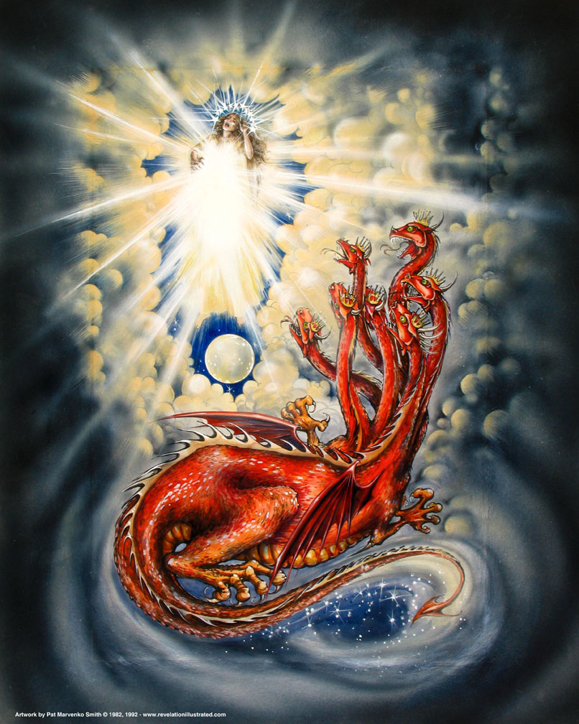
Revelation 12

Slide 19
Chapter 13
January 31, 2021

Slide 20
Resources used:
A Study Of The Book Of Revelation by Bob Dodson
More Than Conquerors by William Hendriksen
Overcoming With The Lamb, Florida College Annual Lectures, February 7-10, 1994
Revelation: An Introduction and Commentary by Homer Hailey
Revelation (Truth Commentaries) by Robert Harkrider
Revelation (A Study Workbook) by Robert Harkrider
Revelation by Donnie Rader
Revelation charts by Keith Greer.
Studies In The Book Of Revelation by Ferrell Jenkins
The Old Testament In The Book Of Revelation by Ferrell Jenkins
The Revelation Of Saint John The Divine by G.B. Caird
The Book of Revelation by Foy E. Wallace
The Avenging of the Apostles and Prophets by Arthur M. Ogden
Worthy Is The Lamb by Ray Summers
Written exchange on “The Domitian Persecution” between Arthur M. Ogden and Ferrell Jenkins presented in Searching The Scriptures, June 12, 1989, pages 7-12

Slide 21
Revelation 12
Causes / Drives
1-11
Describes:
Things on
Earth
Struggle
12-22
Describes:
Forces at Work
in Spiritual
Realm

Slide 22
Revelation 12
1-11
Victory
from the
vantage point
of the
Christian / Earth
12-22
Victory
from the
vantage point
of
God / Heaven

Slide 23
Revelation
II. Christ And The Dragon In Conflict (12-22)
(Deeper Spiritual Meaning)
A. War (12-14)
B. Bowls of Wrath (15-16)
C. Fall of Babylon the Harlot (17-18)
D. Victory of God’s people (19-21)
E. Warnings about the Book (22)

Slide 24
Revelation 13
“The Two Beasts”
The Beast of the Sea (verses 1-10)
The Beast of the Earth (verses 11-18)

Slide 25
Revelation 13
What Is The Point?
Rome
(which is an ally of Satan)
will fail

Slide 26
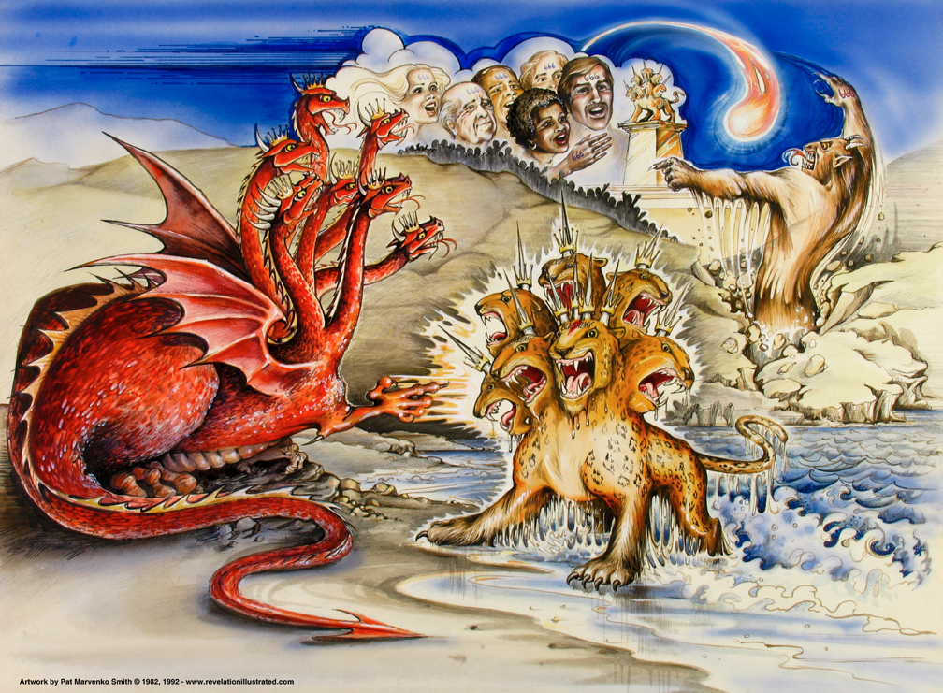
Book of Revelation: Chapter 13
The Battle: Forces of the Conflict
Satan’s Agents – The Two Beasts

Slide 27
Revelation 13:1
Revelation 13
“and he stood upon the sand of the sea. And I saw a beast coming up out of the sea, having ten horns, and seven heads, and on his horns ten diadems, and upon his heads names of blasphemy.”

Slide 28
Satan and His Evil Forces
Revelation 13
Beast out of the sea – political power from the mass of humanity.
“Sea” – cf. Revelation 8:8; 10:2, 8; 12:12; 13:1; 20:13; 21:1
Its origin and appearance – indescribable horror
“He stood on the sand,” dragon awaiting his henchmen (cf. Translations: “He stood …” “I stood …” )
“Coming up out of the sea,” the sea of humanity (Isaiah 17:12) Note similar characteristics of the dragon (12:3)
Having: Ten horns (great power); complete strength, which was given by Satan!

Slide 29
Satan and His Evil Forces
Revelation 13
Beast out of the sea – political power
Its origin and appearance – indescribable horror
“Seven heads,” perfect authority as it was given to him by Satan
“Ten diadems” on his horns. (Satan has them on his head – 12:3) Satan is the true power behind the beast’s royalty.
In either case, the crowns (diademata) portray the idea of royalty and great authority. Not the victory crown (stéphanos).
“Blasphemous names” on his heads instead of crowns; to blaspheme God and His saints. (cf. Daniel 7:7-8, 11, 17-27, esp. verse 25).

